Slide 1
A Manager’s Guide to Performance Management
CAPPA Advocacy
Tyler Wade
tyler@ppldev.com

Slide 2
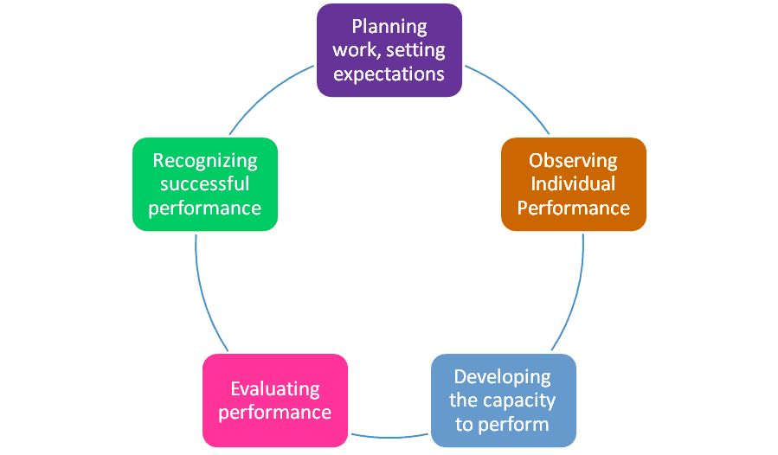
Performance Management Cycle

Slide 3
Performance Management Cycle


Slide 4
The Bottom Line
What are the employee’s major responsibilities for the review period?
How will the responsibilities be measured for success?
Why is the employee doing what he/she is doing?
How will the supervisor and employee communicate and work together to prevent problems and overcome barriers?

Slide 5
Strategic Goals
Agency strategic plan
Department business plan
Unit goals
Unit work results

Slide 6
Performance Goals
Specific
Measurable
Achievable
Realistic
Trackable/Timed
How to write them
State the goal as a result (outcome).
State the measurement(s) that represents the goal.
Check to see if the goal is SMART
Rewrite the goal in a complete sentence (optional).
Test it. “If someone met the measurement, would I be satisfied that they achieved the desired result?”
If yes, great, you’re done. If not, go back to steps 2-5 and make needed changes.

Slide 7
Performance Goals
Performance goals have two main elements:
A result (i.e., outcome, deliverable)
A measurement (i.e., indicator, metric)
Example (tangible result) Closed cases Completed Issue Memo Safe environment | Non-Example (actions only) Work on caseload Research issue Post warning signs and safety tips

Slide 8
Writing Performance Goals
Performance goals have two main elements:
A result (i.e., outcome, deliverable)
A measurement (i.e., indicator, metric)
Example (tangible result) Closed cases Completed Issue Memo Safe environment | Non-Example (actions only) Work on caseload Research issue Post warning signs and safety tips
Result Closed cases Completed Issue Memo Safe environment | Measurement All priority cases closed by 12/15 Management sign-off by 10/30 <1% incidents at local site

Slide 9
Performance Goals
Specific
Measurable
Achievable
Realistic
Trackable/Timed
How to write them
State the goal as a result (outcome).
State the measurement(s) that represents the goal.
Check to see if the goal is SMART
Rewrite the goal in a complete sentence (optional).
Test it. “If someone met the measurement, would I be satisfied that they achieved the desired result?”
If yes, great, you’re done. If not, go back to steps 2-5 and make needed changes.

Slide 10
Performance Management Cycle


Slide 11
Address Individual Performance
Why people don’t do what’s expected of them
Performance Analysis
What it is and when to use it
How to do it

Slide 12
Analyzing Performance Issues
Step | Note
1. What’s the problem? | Describe the discrepancy
2. Is it worth solving? | If no, stop here
3. Can we apply fast fixes? | Clarify expectations, provide resources, provide feedback
4. Are consequences appropriate? | Remove punishments/rewards as approp, provide/rearrange consequences
5. Do they already know how? | Provide feedback, provide practice
6. Are there more clues? | Simplify tasks, remove obstacles, training, replace person
7. Select a solution and draft a plan | Implement and monitor

Slide 13
Exercise: Performance Issues
Pair up and analyze a situation by walking through the first six steps.
Objective: Come up with the most likely cause.
Situations:
Employee who is consistently late
Employee discouraged and thinking about leaving your department
Employee is consistently missing deadlines of action items from meetings
Your choice

Slide 14
Performance Management Cycle


Slide 15
Performance Environment
How to create it
Co-create an Individual Development Plan for each employee.
Provide the necessary tools and resources.
Provide feedback as appropriate.
System-based feedback (online indicators, survey forms)
Manager-based feedback (encouragement, advice)
Coach employees.

Slide 16
Feedback
Two main sources of feedback
System-based
A software program that notifies the operator of errors
Online performance indicators
Peer feedback on rating or evaluation forms
Customer survey forms
A checklist completed by the employee
Manager-based
MBWA
1:1 meetings with the employee
Monitoring indicators, surveys, progress reports
Feedback from others about the employee’s performance

Slide 17
Feedback
Positive
Be specific
Be positive
No mixed messages
Spontaneous
Constructive
Undesired performance
Desired performance
Timing
One issue
Check for understanding

Slide 18
Performance Environment
How to create it
Co-create an Individual Development Plan for each employee.
Provide the necessary tools and resources.
Provide feedback as appropriate.
System-based feedback (online indicators, survey forms)
Manager-based feedback (encouragement, advice)
Coach employees.

Slide 19
Performance Management Cycle
☞

Slide 20
Appraise Performance
No surprises
Congruence of informal and formal feedback
Formal Performance Appraisals
How to write them
How to deliver them

Slide 21
Writing the Appraisal
Guide employees to write their own
Gather performance information
Including employee’s input from Step 1
Write the appraisal
Include meaningful, job-specific examples
Be concise – eliminate wordy expressions
Edit feedback to maintain confidentiality
Use specific examples of observable skills, behaviors, and knowledge
Do not reference personal traits or job-protected leaves of absence
Avoid using abbreviations and acronyms

Slide 22
Deliver the Appraisal
Review feedback guidelines
Review the purpose of the review as a tool
Clear, honest, and direct
Acknowledge accomplishments
Drive continuous improvement
Provide accurate performance data
Delivery guidelines
Deliver the review in a private location
Message and tone consistent with tone of the review
Message based on a factual representation of the written review

Slide 23
Performance Management Cycle
☞

Slide 24
Inexpensive ways to recognize
Speak encouraging words spontaneously
Give out recognition letters
Create “Behind the Scenes Recognition Certificates”
Coordinate a “Thank you” call from the Director or Chief

Slide 25
Meaningful Recognition
1. Identify the contributors
Name the person/people you want to recognize.
2. Set the stage and paint the scene
Where and when did this happen? What else was going on? What was the person (or persons) trying to achieve?
3. Describe the action
Relate in as much detail as you can what happened. What specifically did each of the people involved do?
4. Tell how it ended
Tell the audience what happened in the end. What happened as a result of the actions?
5. Include a surprise (optional, but highly recommended)
Try to add an element of amazement. What makes this story particularly interesting, memorable, funny or surprising?
Notes:
25

Slide 26
Wrap-up
Final question or comments?
Evaluations
Tyler Wade | tyler@ppldev.com
26

