Slide 1
All in the Spirit of Teamwork
CAPPA Advocacy
Tyler Wade
tyler@ppldev.com

Slide 2
Section 1
Understand Teams
Essential Elements
  What it takes
  Why do teams fail?
The Tuckman Model
Team Leader Style

Slide 3
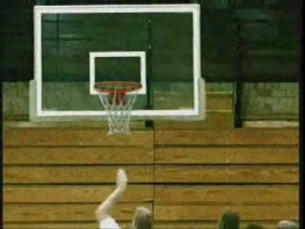
Areas of Excellence
Communication
  Quantity and quality
Trust
Collaboration
Differences
Conflict
  Type and frequency

Slide 4
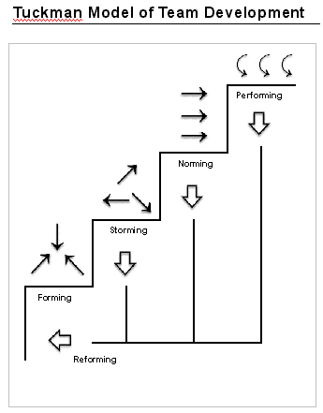
The Tuckman Model
Team Development Stages

Slide 5
Team Development Stages
What’s Going On

Slide 6
What could happen?
What could happen if a supervisor or team leader doesn’t understand the stages of team development?

Slide 7
What Else Could Happen?
What happens when a manager is lightly involved in Setting Goals with a Forming team?
What happens when a manager is heavily involved in Advice with a Performing team?

Slide 8
Section 2
Appreciate Teams
The Value of Teams
Teamwork considerations
  Squares
  What do you see?

Slide 9
Squares
Number of squares: _______

Slide 11


Slide 12
CA Trivia & Symbols
Nickname
Motto
Language
Highest point
Lowest point
Governor
Bird
Freshwater fish
Saltwater fish
Flower
Insect
Mammal
Reptile
Tree
Beverage
Color(s)
Color(s)
Mineral
Soil
Song

Slide 13
















Slide 14
Section 3
Establish Teams
Assemble the team
Organize the team
Empower the team
Introduce team process plan

Slide 15
How to Establish Teams (continued)
Step 4 – Introduce a team process plan.
  This plan establishes team interaction and norms that the team will follow towards achieving their deliverables.
  Refer to it often and adapt it as necessary.

Slide 16
Key Team Process Elements
Team goals
Ground rules
Defined responsibilities of members
Defined responsibilities of management
Effective meetings
Agreed-upon:
  problem solving model
  decision making model
  conflict management model
Recognition and celebration

Slide 17
Section 4
Develop Teams
Find out the stage/level of the team
  Give the team what it needs
Address three areas
  New ideas
  Relationships
  Growth and self assessment

Slide 18
Wrap-up
Action Plan
Final questions or comments?
Thank you!
tyler@ppldev.com
Notes:
Page 18
Wrap-up and Action Plan (03:15 to 03:30)
Go through the bullets on the slide, especially the Action Plan, which will take about 10 minutes

