Slide 1


Creating a Psychologically Safe Workplace
Three Strategies for Effective Team Interaction
Scott Gardner
Antoinette Joy
Dennis Wade
Tyler Wade
INFO@PPLDEV.COM

Slide 2
Objectives
By the end of this presentation, you will know:
What psychological safety is and why it matters
The symptoms for recognizing when your team lacks psychological safety
Strategies for building psychological safety on your team
A specific tool and technique for building psychological safety on your team
2

Slide 3
What is Psychological Safety (PS)?
A belief: the team is a safe place for taking risks
Team members won’t embarrass or punish each other for:
  Making a mistake
  Asking a question
  Offering a new idea
It doesn’t mean your ideas won’t be challenged or you won’t like the answer
It means you get the best from team members
3

Slide 4
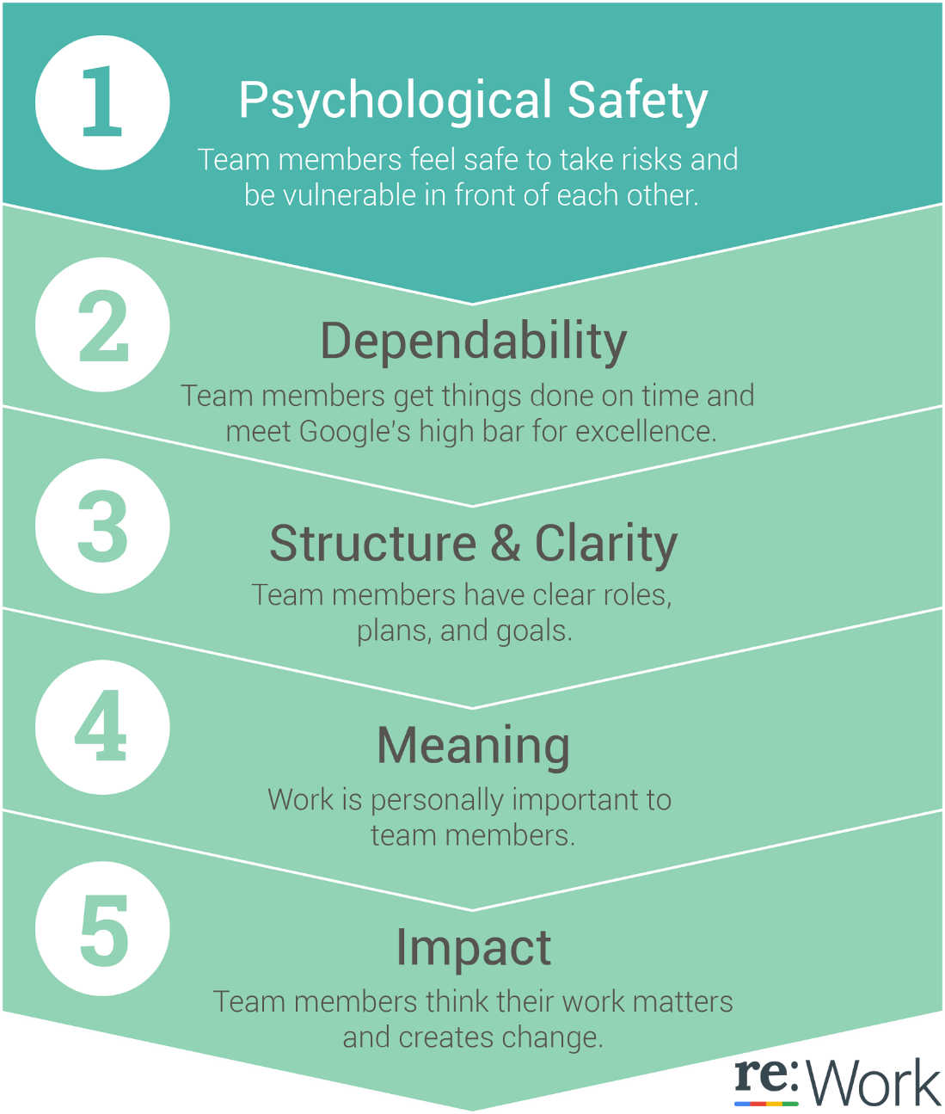

Dynamics of Effective Teams
4

Slide 5
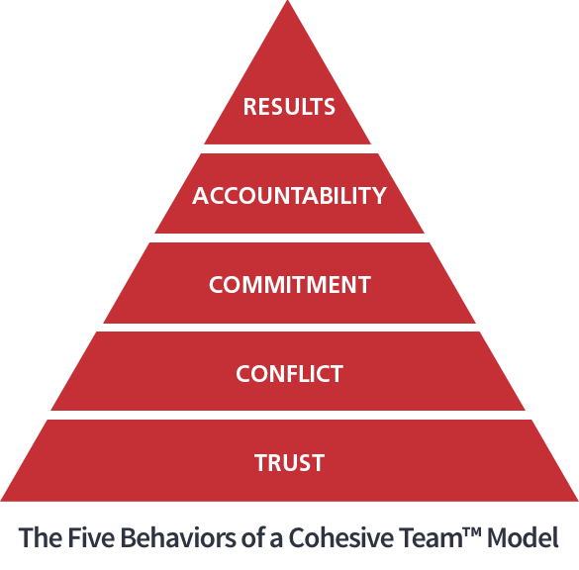
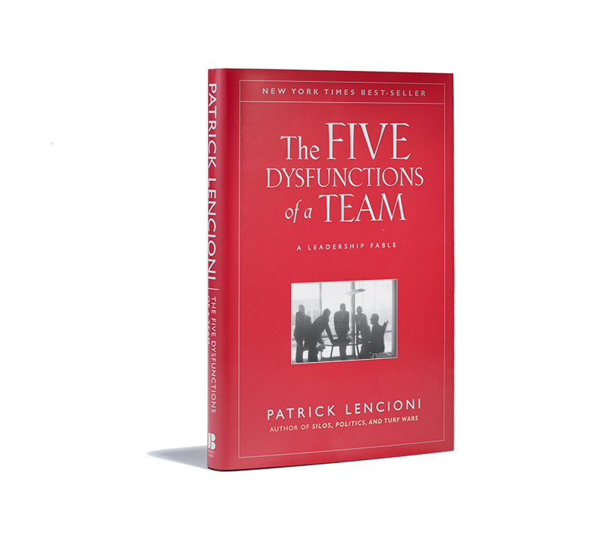
5

Slide 6

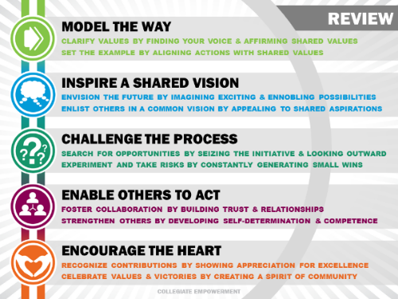
6

Slide 7

Symptoms of a team lacking PS
Team members will:
  Conceal their weaknesses and mistakes from others
  Hesitate to ask for help or provide constructive feedback
  Waste time and energy managing their behaviors for effect
  Hold grudges
  Dread meetings and find reasons to avoid spending time together
  Have boring or irrelevant meetings
  Ignore controversial topics that are crucial to team success
  Have a meeting outside of the meeting
7

Slide 8

Three strategies for building PS
Demonstrate engagement
  Be present – put away your laptop and smartphone
  Offer input
  Check body language and facial expressions
Show understanding
  Validate comments
  Ask questions for understanding
  Focus on the situation or issue, not the person
Be inclusive
  Express gratitude
  Be approachable
  Solicit input, opinions, and feedback from teammates
  Don’t interrupt
  Respect the agreed-upon decision-making method
8

Slide 9
A tool for building PS: A Team Operating Agreement (TOA)
A team operating agreement – what is it?
Why have a team operating agreement?
How to create one
Exercise
  Individually, read through the operating agreement handout and:
    Check items your team currently does
    Circle items you would like to start doing (three minutes)
9

Slide 10
A technique for building a TOA:
The Nominal Group Technique
Benefits of the Nominal Group Technique
Exercise
  Individually, brainwrite as if you were back at work building a TOA
  At your table, a facilitator will collect ideas on a flipchart
Be ready to share what’s on your group’s TOA
10

Slide 11
Thank you!
Final questions or comments?
Next steps
info@ppldev.com
Bibliography
  re:Work, www.rework.withgoogle.com/guides
  The Five Dysfunctions of a Team, Patrick Lencioni
  The Five Keys to a Successful Google Team, Julia Rozovsky
11

