Slide 1

Workforce Engagement and Succession: The Boomer-to-Millennial Handoff
Dennis Wade – dennis@ppldev.com
Tyler Wade – tyler@ppldev.com

Slide 2
Overview

Slide 3
Objectives
Participants will:
  Understand the meaning and value of employee engagement
  Identify strategies for retaining critical skills and knowledge that your organization needs from Baby Boomers
  Learn how to retain and quickly develop valuable Millennials

Slide 4
Agenda
Overview
Refresher
Engagement principles for all generations
Boomer engagement
Millennial engagement
Next steps

Slide 5
Refresher

Slide 6
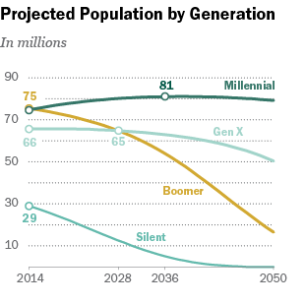
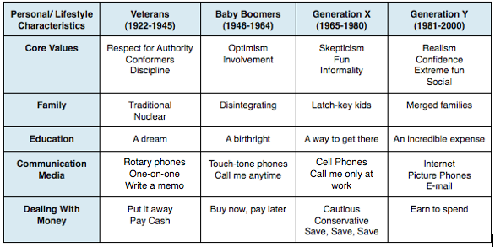
Generations Refresher

Slide 7
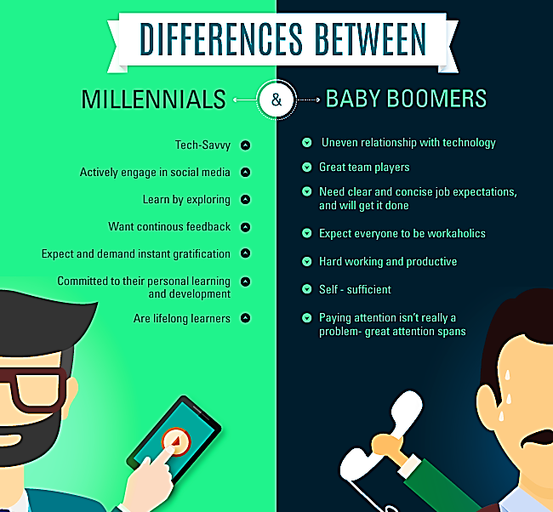

Slide 8
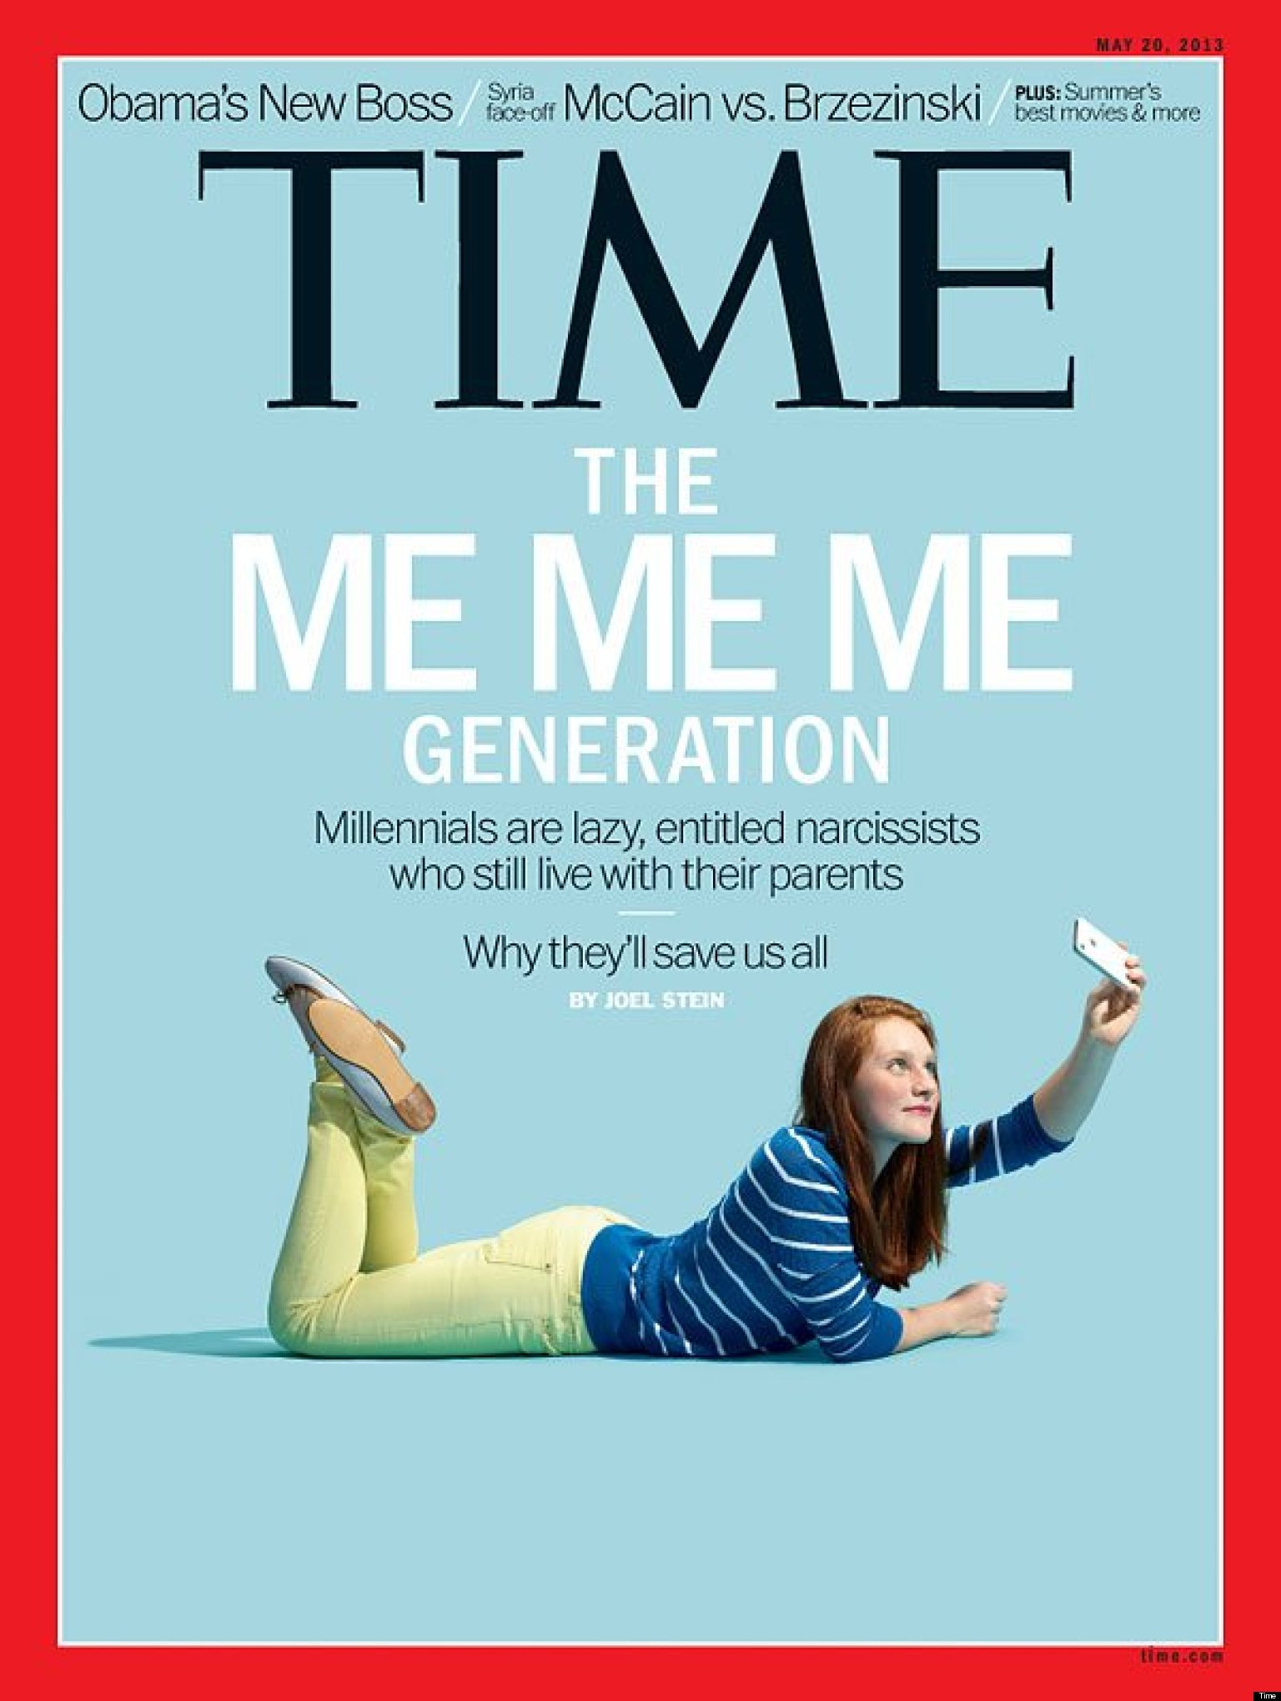
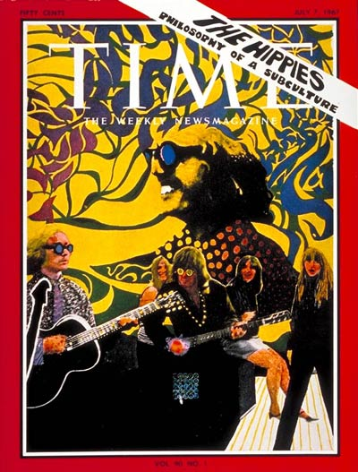
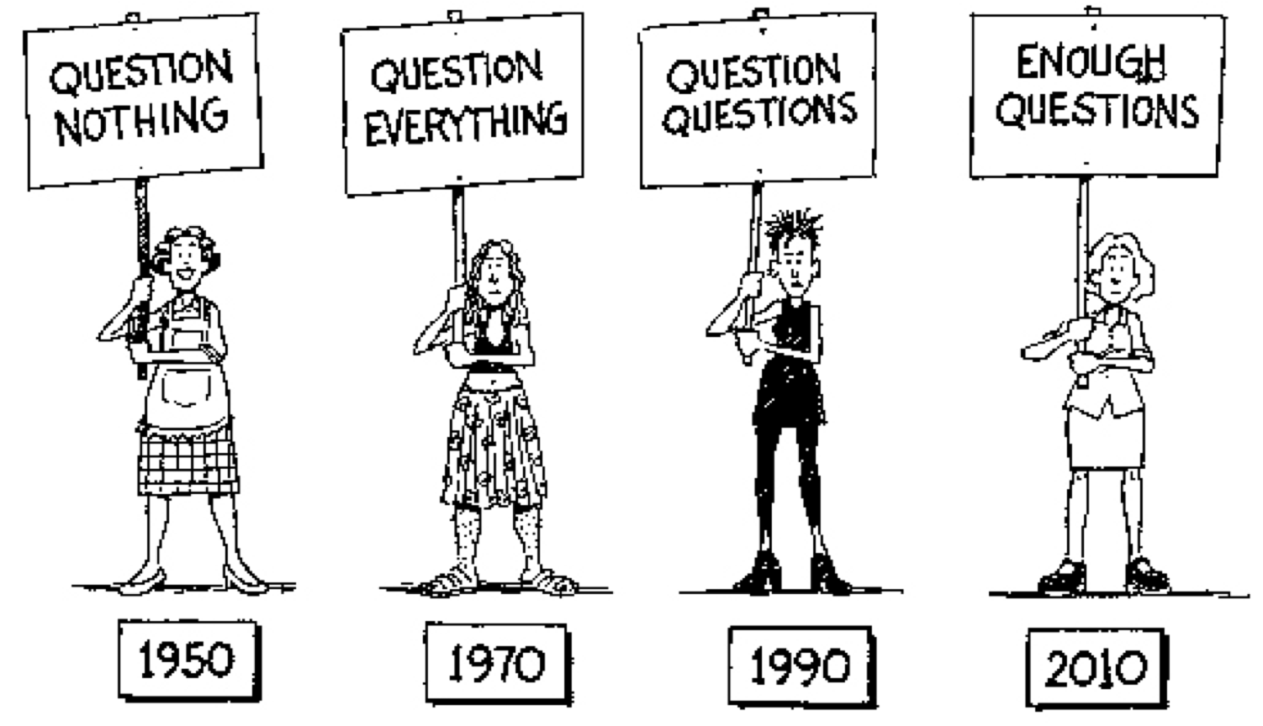
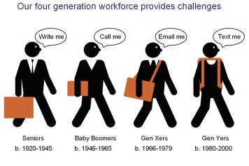
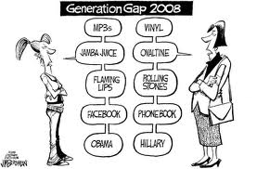
Generations Refresher Stereotypes

Slide 9
Key Definitions
Engagement is the degree to which employees are involved in and enthusiastic about their work and workplace
Succession is the progressive replacement of those who are retiring
  Handoff is the transfer of Boomer knowledge and skills to Millennials so they develop faster and easier

Slide 10
Engagement Principles for All Generations

Slide 11
Assumptions about the generations leads to…
86% of HR professionals across 20 different sectors view millennials differently than previous generations
More than 60% of 1,546 high-level HR and learning professionals consider generational differences when approaching instructional design
Social learning has increased in popularity in recent years

Slide 12
Empirical research suggests otherwise
Numerous studies show Millennials like learning online less than their Baby Boomer counterparts
Twenge and Campbell showed that generational differences are almost non-existent in regard to work values
Gallup polling shows that although Boomers are less engaged, there is overlap in engagement factor

Slide 13
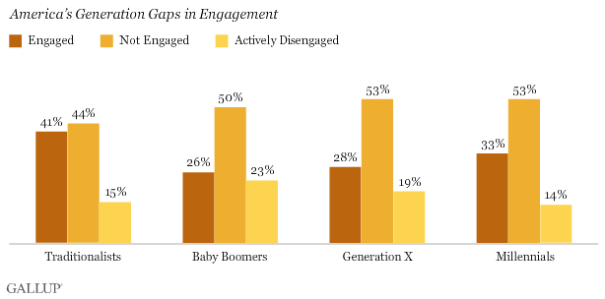
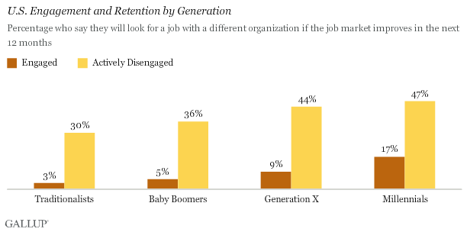

Slide 14
Gallup Survey data shows
Only 30% of all U.S. employees -- and a mere 13% of workers worldwide -- are engaged in their jobs
Managers, in particular, account for up to 70% of the variance in employee engagement across business units
Eight out of ten managers are unwilling, unable, or unprepared to motivate and engage their employees

Slide 15
Everyone Needs…
Communication
  Do you believe that there is frequent, consistent two-way communication?
Growth and Development
  Do you believe that you are learning new things and advancing in your career?
Recognition and Appreciation
  Do you feel appreciated?
Trust and Confidence
  Do you trust the leadership and have confidence in your company’s future?

Slide 16
Boomer Engagement

Slide 17
Organizational Goals of Engagement
Overcome RIP syndrome
  If Boomers are retired-in-place, they will not help the organization achieve the next two goals
Documentation of WAO knowledge
  If “work and organizational” knowledge is not documented, the last goal won’t likely be achieved
Succession
  If WAO is not passed on to newer generations, succession is reactive and not very effective
Reduce costs of turnover
  Hiring, training, lost productivity

Slide 18
Potential Means of Engagement
Opportunity to do what they do best
Interesting & enjoyable work
Feel connected to the mission and purpose
Caring managers who show interest in employees’ work and life

Slide 19
Millennial Engagement

Slide 20
Organizational Goals of Engagement
Develop Millennials quickly
  If they can develop quickly, they can assume leadership roles that are being vacated at a historic rate
Production
  Workers who are engaged are more productive than those who aren’t
Retention
  Workers who are engaged are more likely to stay with the company

Slide 21
Potential Means of Engagement
Growth and development
  Opportunities to learn, grow, and move up the ladder
Opportunity to do what they do best
Help them connect to the mission and purpose of the organization

Slide 22
Next Steps:
Engagement and Hand-off Strategies

Slide 23
Next Steps
HR
  Deprogram “generational differences”
  Effective Performance Management System
  Mentoring/Coaching Initiatives
Employees
  Integration Plans
  Connect to Mission/Vision
  Individual Development Plans
  Build Relationships

Slide 24
Next Steps
Managers
  Emotional Intelligence/Communication
  Performance Management
  Mentoring/Coaching
  Facilitate the “Handoff”
The “Handoff”
  Documentation and transfer
    Knowledge
    Experience
  Getting Boomers on board

Slide 25
Resources
Employee Engagement for Everyone, Kevin Kruse, Kruse Publications, 2013
Working with Generations: Breaking the Stereotypes (2014)–www.performancexpress.org/2014/03/working-with-generations-breaking-the-stereotypes/
Blatantly Incorrect Generational Stereotypes: Communication Methods by Generation (2014)–www.huffingtonpost.com/crystal-kadakia/blatantly-incorrect-gener_b_4935179.html
Intergenerational Dynamics, Jessica Kriegel (2015)–www.cajpa.org/sites/default/files/4-Jessica-KriegelIntergenerationalDynamics.pdf
Twenge, Jean M., et al. "Generational Differences in Work Values: Leisure and Extrinsic Values Increasing, Social and Intrinsic Values Decreasing." Journal of Management 36.5 (2010): 1117-42. Print.
Why Millennials Don’t Care (2015)–www.entrepreneur.com/article/246437
Maximizing Millennials in the Workplace, Jessica Brack, UNC Business School, 2012
There’s a Generation Gap in Your Workplace (2013)– www.gallup.com/businessjournal/163466/generation-gap-workplace.aspx
Employees are Responsible for Their Engagement Too (2015) – www.gallup.com/businessjournal/183614/employees-responsible-engagement.aspx?g_source=EMPLOYEE_ENGAGEMENT&g_medium=topic&g_campaign=tiles

Slide 26
Ideas generated during presentation
Base-level knowledge
  SMEs share
Collaboration among employees---cross-training, OJT, documentation
Focus groups—all generations—round table discussions
Back-up employees while on vacation, sick—coverage and skills development
Intranet/Sharepoint is a knowledge depository
  Best methods
  Project/Process documentation
Cross-department knowledge transfer
  Best practices
  Break down silos
  Lean/Kaizen/process improvement events
Invite retirees to come in, share knowledge and document (90-day contract or other)

Slide 27
Wrap-up
Final questions or comments?
info@ppldev.com
(800) 693-1359
Thank you!

